Slide 1
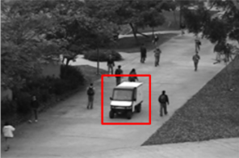
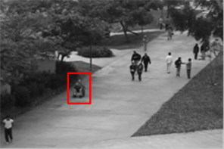
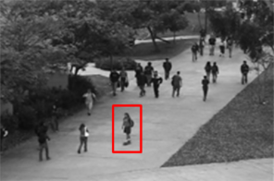
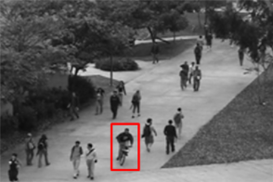
Datasets
UCSD Anomaly Detection Dataset
Peds1: clips of groups of people walking towards and away from the camera, and some amount of perspective distortion. Contains 34 training video samples and 36 testing video samples. Peds2: scenes with pedestrian movement parallel to the camera plane. Contains 16 training video samples and 12 testing video samples.
Abnormal events:
The circulation of non pedestrian entitles in the walkways
Anomalous pedestrian motion patterns
Cart
Wheelchair
Skater
Biker

Slide 2
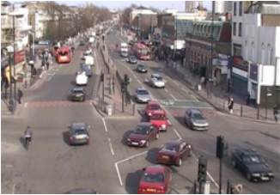
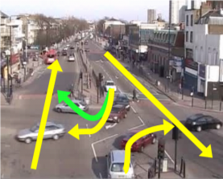
QMUL Junction Dataset
A busy traffic dataset for research on activity analysis and behavior understanding.

Slide 3
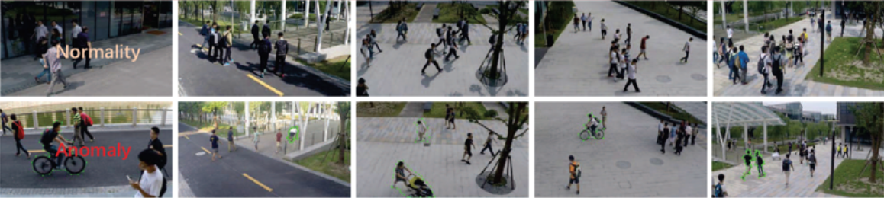
ShanghaiTech Dataset
It contains 330 training videos and 107 testing ones with 130 abnormal events. Totally, it consists of 13 scenes and various anomaly types.

Slide 4
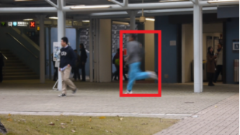
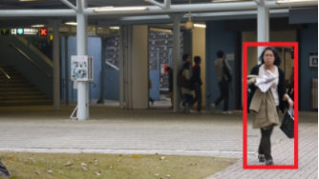
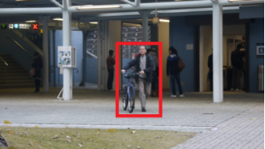
CUHK Avenue Dataset
It contains 16 training videos and 21 testing ones with a total of 47 abnormal events. one mins for each clips.
Strange action
Wrong direction
Abnormal object

Slide 5
Our Dataset and goals:
Anomaly detection considering all anomalies in one group and all normal activities in another group.
For recognizing each of anomalous activities. (trespass and suicide)

Slide 6
Anomaly Detection
(Trajectory) Tracking-based Anomaly:
Chaotic invariants of Lagrangian particle trajectories for anomaly detection in crowded scenes, 2010
Learning object motion patterns for anomaly detection and improved object detection, 2008
Dictionary learning-based methods:
Video anomaly detection and localization using hierarchical feature representation and gaussian process regression, 2015
Abnormal event detection at 150 fps in matlab, 2013
Anomaly of a specific event: Detect violence or aggression in video
Violence detection using oriented violent flows: Optical flow + SVM, 2016
Muti-model human aggression detection: Video + Audio, 2015
Angry Crowd: Detecting violent Events in Videos: heuristic map + classification, 2016

Slide 7
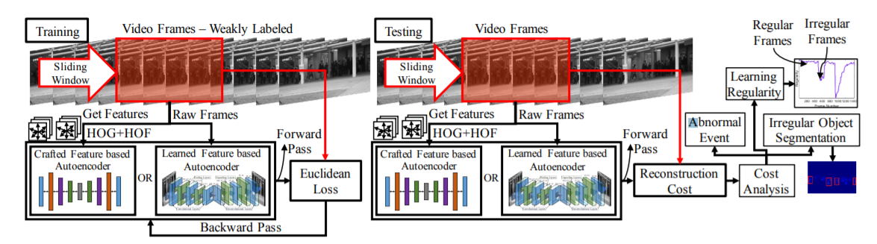
Deep learning-based methods:
Learning temporal regularity in video sequences. (CVPR2016)
Histograms of Oriented Gradients (HOG), Histograms of Optical Flows (HOF) and autoencoder.

Slide 8
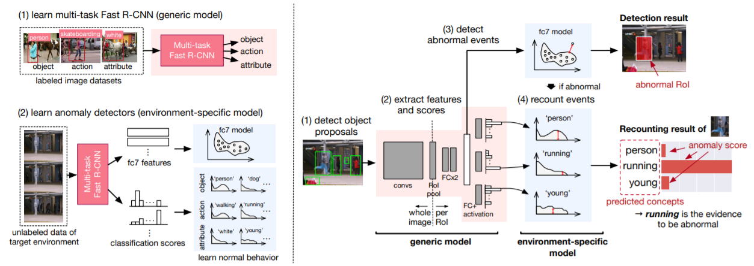
Joint Detection and recounting of abnormal events by learning deep generic knowledge, CVPR2017
Detect objects.
Extract features (and classification scores)
Classify normal/abnormal semantic features : the anomaly scores of each objects by applying the anomaly detector to semantic of the proposal.
Recount abnormal events: (objects, actions, and attributes) of abnormal events are predicted from classification scores.

Slide 9
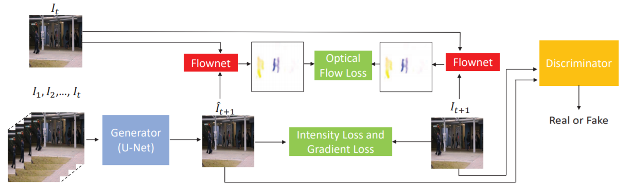
Future frame prediction for anomaly detection–a new baseline, CVPR2018
Empolying U-Net as generator to predict next frame, and compare the prediction with its ground truth for anomaly detection.

Slide 10
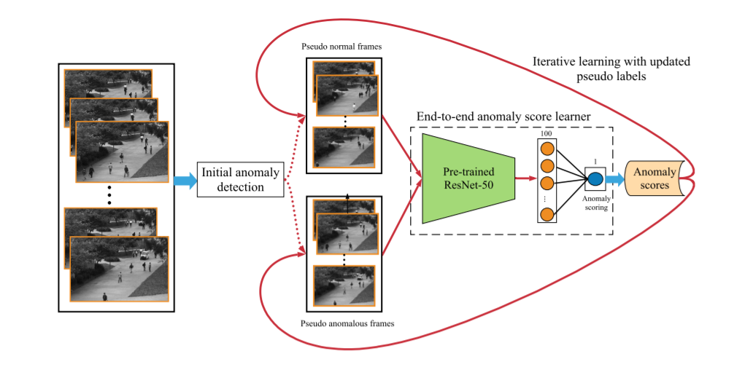
Self-trained Deep Ordinal Regression for End-to-End Video Anomaly Detection, CVPR2020
Formulate the problem as a self-training ordinal regression task. The End-to-end approach unifies these two modules and directly learns the anomaly scores from the raw inputs.

Slide 11
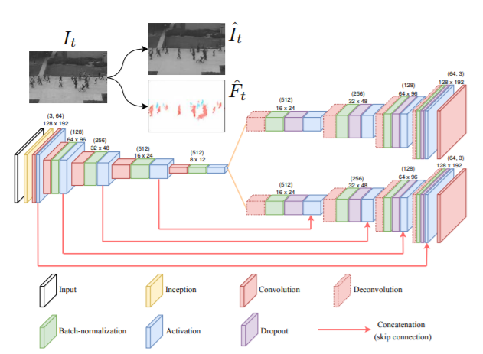
Slides 11-18
The state-of-the-art anomaly detection. (Supervised Learning)
Anomaly Detection in Video Sequence with Appearance-Motion Correspondence (ICCV2019)
Reconstructed frame
Optical flow
Appearance decoder
Common
encoder
Motion decoder

Slide 12
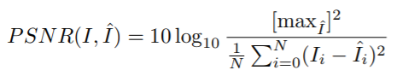
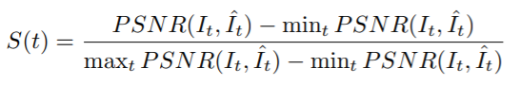
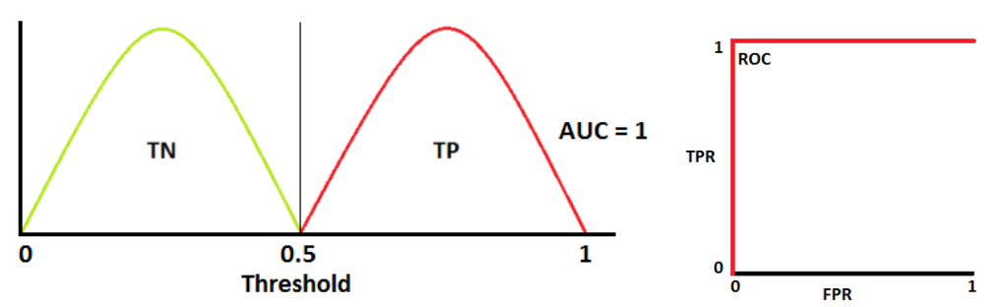
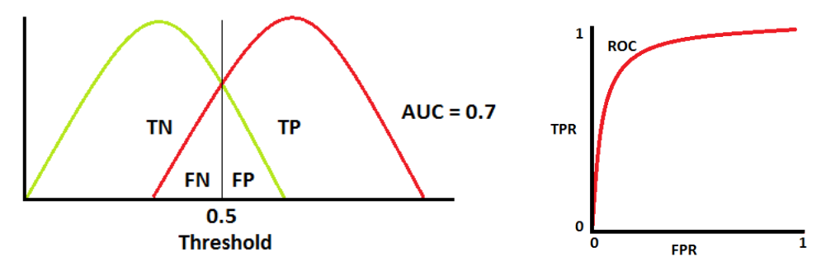
To decide an anomaly event according to the predicted frames: Threshold the anomaly score
Evaluation Metric:
Receiver Operation Characteristic (ROC): Plotting the TPR against the FPR
Area under curve (AUC): Presents degree or measure of separability

Slide 13
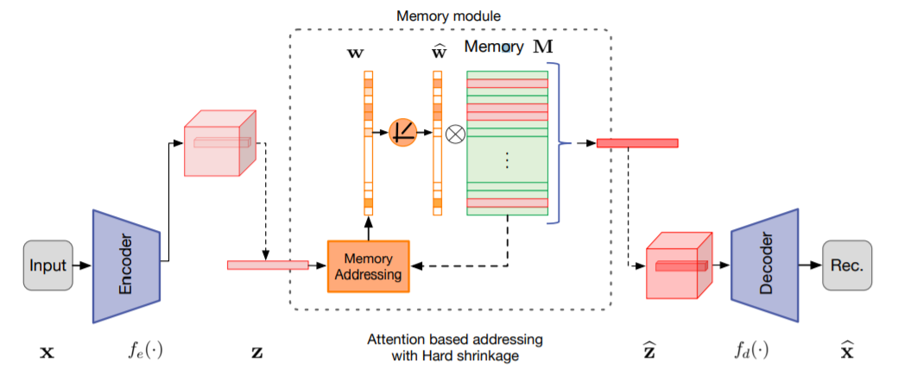
The state-of-the-art anomaly detection. (Unsupervised Learning)
Memorizing Normality to Detect Anomaly: Memory-augmented Deep Autoencoder for Unsupervised Anomaly Detection
(ICCV2019)

Slide 14
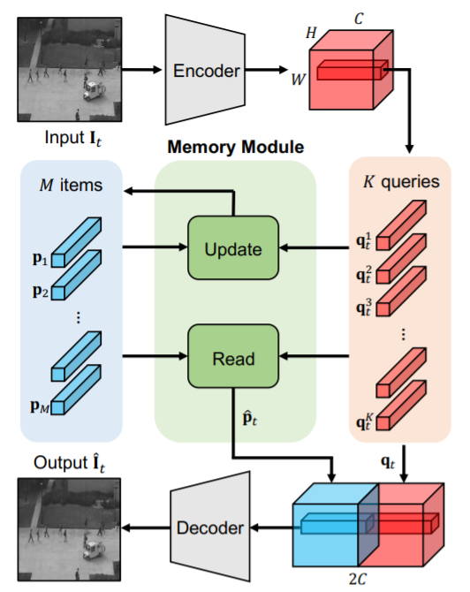
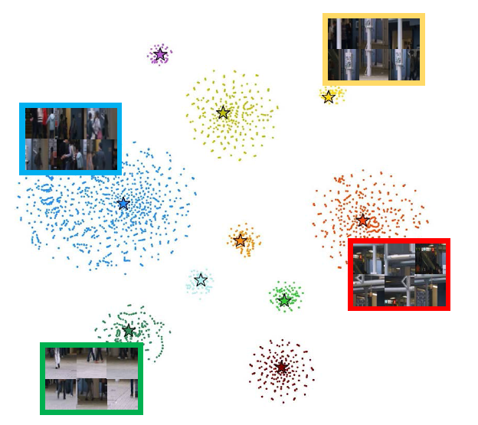
Learning Memory-guided Normality for Anomaly Detection (Unsupervised) (CVPR2020)

Slide 15
12-2
Retrain on the UCSD Ped2 dataset
Peds2: scenes with pedestrian movement parallel to the camera plane. Contains 16 training video samples and 12 testing video samples.
Abnormal events:
The circulation of non pedestrian entitles in the walkways
Anomalous pedestrian motion patterns
Cart
Wheelchair
Skater
Biker

Slide 16
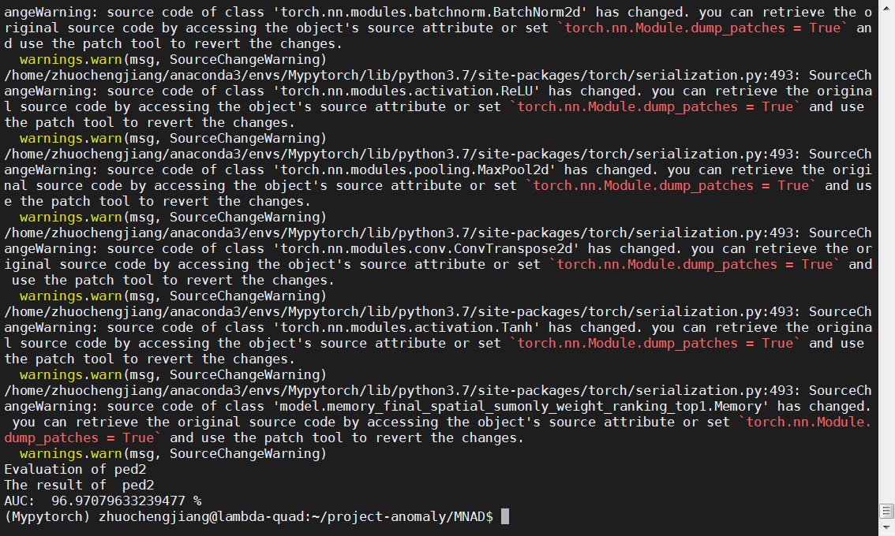
Retrain on the UCSD Ped2 dataset:

Slide 17
Dataset searching for anomaly detection at railroad crossing
Suicide behavior analysis
No available video dataset, current analysis based on the text, image information from social media.
Commit suicide at railway:
https://www.youtube.com/watch?v=SXnNh7aMmis&bpctr=1608135402
Railway crossing anomaly detection:
Found some accidents video clips happened at the railroad crossing (different railroad crossing scenes)
Cannot find abnormal behavior such as potentially commit suicide

Slide 18
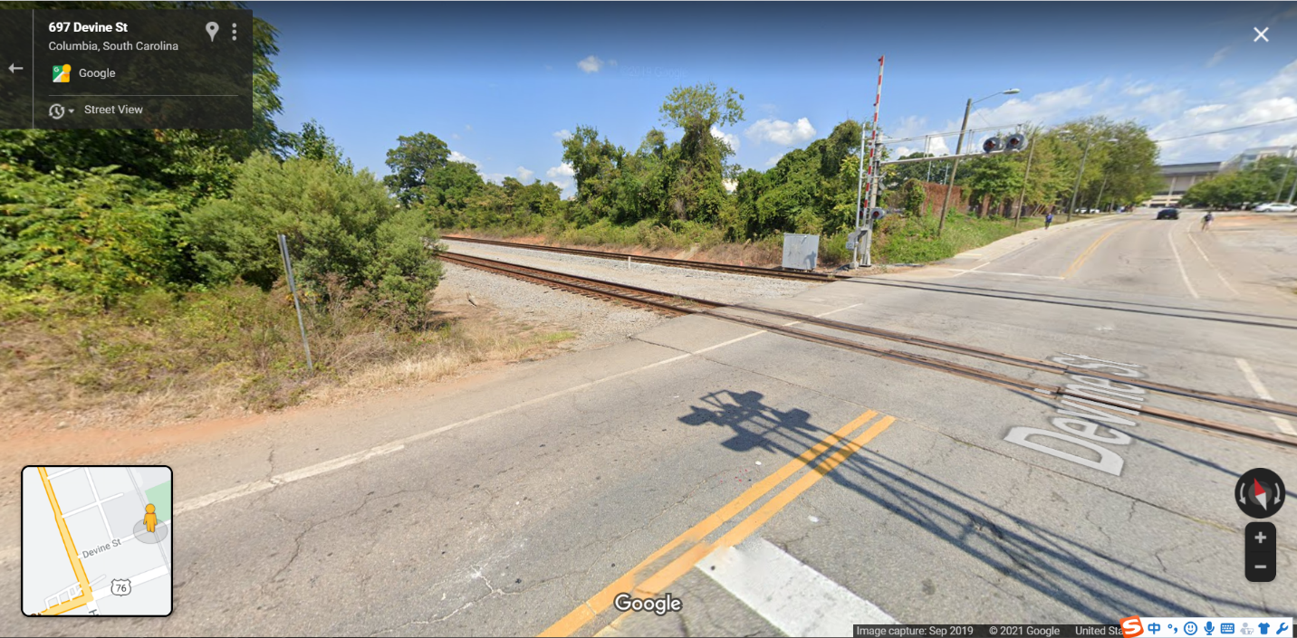
Data collected at the grade crossing (697 Devine St, Columbia, SC)

Slide 19
Anomaly behaviors included:
Pedestrian walk along with the railway.
Pedestrian stop and talk/play/sit at the grade crossing.
Pedestrian damage the facilities on the railroad.
Pedestrian wander at the grade crossing (suicidal tendency).

Slide 20
Anomaly Localization
D. Abati, A. Porrello, S. Calderara and R. CucchiaraLatent Space Autoregression for Novelty Detection, arXiv:1807.01653, 2019.
Code: https://github.com/aimagelab/novelty-detection
M. G. Narasimhan and Sowmya Kamath S., Dynamic anomaly detection in crowded scene videos using sparse autoencoders. Multimedia Tools and Applications. June 2017.
Code: https://github.com/medhini/Anomaly-Detection
D. Xu, “Learning Deep Representations of Appearance and Motion for Anomalous Event Detection.” arXiv:1510.01553, 2015.
Code: https://github.com/nabulago/anomaly-event-detection

Slide 21
